Slide 1
Welcome to Kindergarten

Slide 3
Aims
Being, Belonging, Becoming
Foster a love of learning
build confidence
Make friends
Learn patience and tolerance
Develop social skills
Fun
Literacy skills and numeracy skills

Slide 4
SCHOOL VISION
We provide every student with an education to succeed in our changing world. Our students reflect our four core values of responsibility, respect, caring for others and personal best. They are successful learners who are confident and creative global citizens.

Slide 5
SCHOOL MISSION
At North Kalgoorlie Primary School our mission is to provide engaging and challenging educational experiences that target all students. Our whole school coordinated approach to learning will ensure that all students have the opportunity to succeed, regardless of background, gender, culture or ability. A safe environment, where expectations and boundaries are clear and consistent, will underpin the learning environment and four core values. We will work together to develop innovative strategies and programs that respond to the needs of our students and community because we believe EVERY CHILD MATTERS.

Slide 6
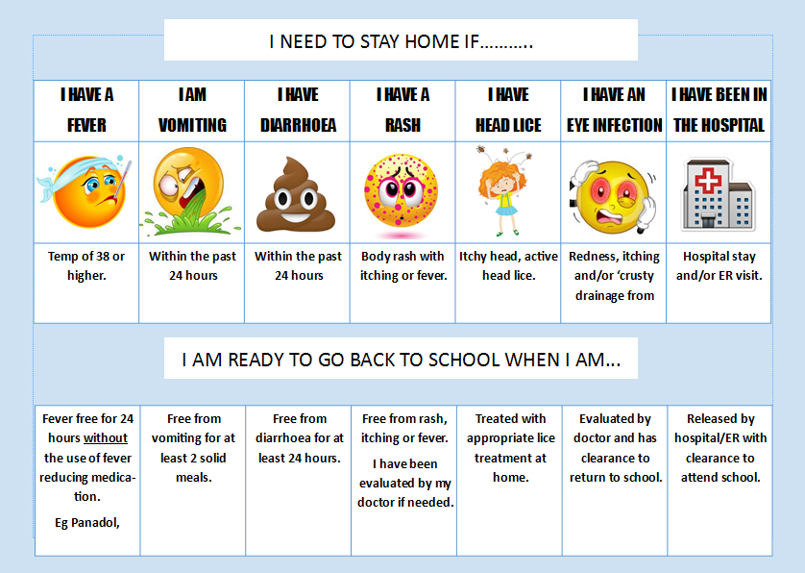

Slide 7
Classroom Rules
We all have the right
to feel safe at all times
We try new things
We try our best
We are kind
We respect each other
We all belong

Slide 8
Behaviour Management
Unwanted school behaviours
123 Magic and emotion coaching
PATHS program (promoting alternative thinking strategies) used to help teach children to identify emotions and learn how to deal with their own emotions and the emotions of those around them.
Promoting Positive Behaviours
Class praise, encouragement from peers.
PATHS Kid of the Day (Promoting Alternative Thinking Strategies)

Slide 9
123 Magic and Emotion Coaching in the Classroom
What?
It is an Emotion Coaching and a discipline program that we will be using in the classrooms.
It is a program that incorporates specific, gentle-but-firm techniques to stop undesirable behaviour as well as to encourage positive behaviour.
Why?
Teaching is our number 1 priority of the school day!

Slide 10
So how does it work?
Step 1 – involves managing undesirable behaviour by counting 1, 2 or 3. On the count of 3 the student will have to take a short think break, or sometimes a privilege may be removed. This simple technique is remarkably effective when applied with the three principles of the program.
Step 2 – involves the encouraging of good behaviour, for example respect, listening skills, organisational skills, taking turns and thinking of others.
Step 3 – teaching children valuable tools for building healthy relationships with children, including active listening and shared fun.
Emotion coaching – alongside the management of behaviours in the classroom through emotion coaching we are helping children to develop a better understanding of their own emotions and the emotions of others.
Therefore becoming better at managing their emotions and being able to take responsibility for their own behaviour.

Slide 11
School Priorities
LITERACY AND NUMERACY
Literacy Block
Phonics – Diana Rigg PLD (Promoting Literacy Development)
Modelled/Guided Writing
Term 1 focus – syllables, rhyme, name recognition, name writing, fine motor development
Numeracy Block
Top ten mathematics program
Paul Swann Maths Milestones
Bond Blocks
Term 1 focus – recognising and reciting numbers to 5, simple patterns, 2D shapes, more or less tasks and subitising

Slide 12
Collection of Children
-Children must be brought to the classroom by an adult
Adults must supervise their child and wait with them until staff open doors at 8.45am
We ask that families are punctual for both drop off and pick up
If you are running unavoidably late for collection please phone kindy on
9021 4401
Please notify staff if your child is being picked up by someone other than a parent/guardian. Where possible notify via a written note to your classroom teacher.

Slide 13
Parent Help
-Parents are an integral part of the learning program at NKPS, we will be commencing parent help in our classrooms in Term 2.
Term 1 is all about settling children into the rules and routines of kindergarten, as well as developing our relationships with children.
There will be parent help rosters at each classroom for you to be able to write your name down, and come and enjoy the fun and creativity of kindergarten.
It is preferable not to bring in younger siblings.
Parent help runs first thing in the morning from 8.45am – 10.30am.

Slide 14
No Hat/ Play in the Shade
North Kalgoorlie Primary is a Sun Smart School, and has policy which directs us to ensure that all children are wearing hats when they are playing outside.
Hats need to be broad brim hats, caps are not acceptable sun protection for school.
Sunscreen – each room has sunscreen outside their door every morning. Please feel free to use this and apply to your child each day.
Head lice
If you discover that your child has head lice or nits, please notify staff immediately and exclude your child from kindergarten until he or she has been treated.
We will notify all parents in the class and ask them to check their child’s hair.

Slide 15
Birthdays
Parents are more than welcome to send in a birthday cake or birthday cupcakes to school to celebrate their child’s birthday.
At kindy we sing happy birthday and give the child a small momento.
If for any reason you do not want your child to participate in these celebrations, please let us know.
Allergies
Please take note of any allergies within the classroom. Please send in cakes/products which are nut free.
If your child has an allergy you may wish to supply some ‘safe’ birthday cupcakes in to school for us to keep in the freezer and hand out to your child on these occasions.

Slide 16
Allied Health Service
During the year we work closely with Allied Health Services team from the Kalgoorlie Regional Hospital.
Physiotherapists, Speech Therapists and Occupational Therapists.
If you have any concerns regarding your child in these areas you can request a referral through teaching staff. Similarly, if we have any concerns with your child in these areas , we will discuss these with you and if agreed upon refer your child for further services.
Health Nurse
Our school nurse this year is Mrs Michelle Wynne.
With parental consent, Michelle will do a health screen on all kindergarten children starting in term 2. Health forms will be sent to parents, please return these to school ASAP.

Slide 17
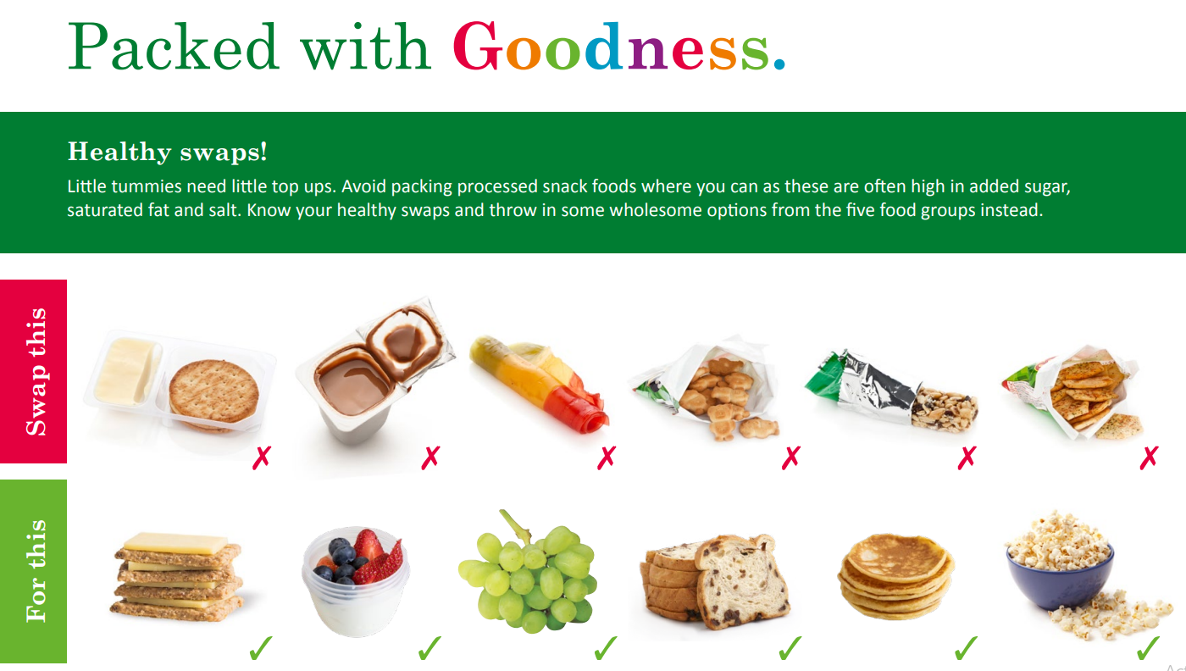
Food at kindy

Slide 18
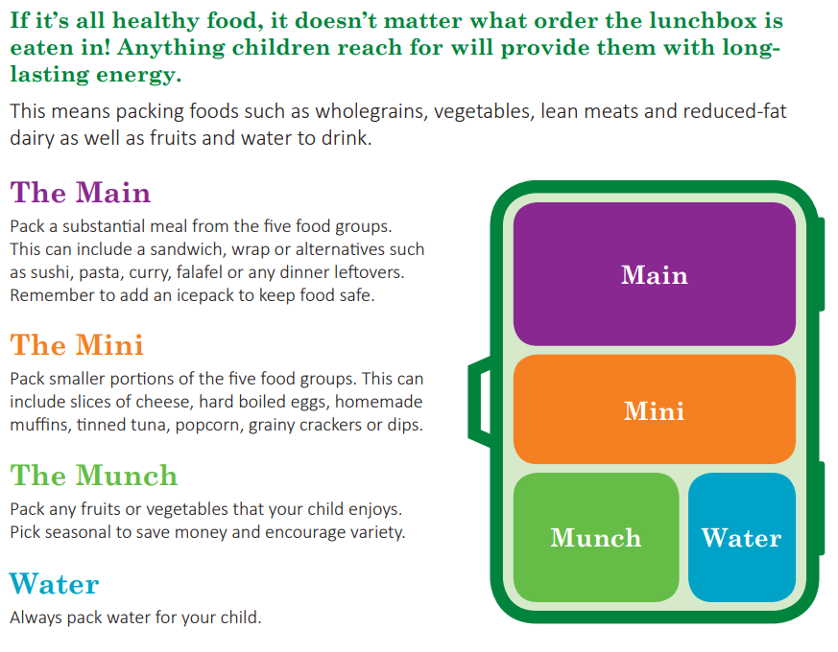

Slide 19
Reminder that the Kindy playground is not for use before or after school times.

Slide 20
Parents As Partners
Things you can do to help your child’s education:
Attendance : They have to be at school to learn. Less than 90% is considered at Educational Risk
Home Reading :Comprehension readers or any books at home read to your child on a regular basis assists with your child’s literacy understanding and development.
See us regarding any issues A.S.A.P
Please ensure contact details up to date.

Slide 21
Thank you for being
here today!

Slide 22
Phone the school on 9092 5850 or Kindy on 9021 4401
To make an appointment with your classroom teacher.
Email – kylie.sutton@education.wa.edu.au
Margaret.miller@education.wa.edu.au
Contact Details

