Slide 1
Pre-primary
Parent Information
Session 2024

Slide 2
School Vision
We provide every student with an education to succeed in our changing world. Our students reflect our four core values of responsibility, respect, caring for others and personal best. They are successful learners who are confident and creative global citizens.

Slide 3
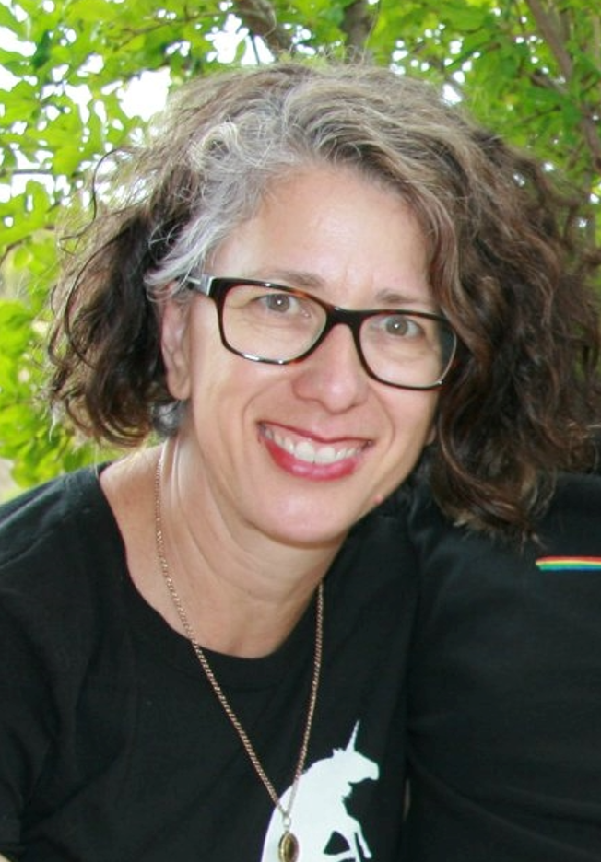
About Me Mrs Louise Hurst Flanagan Pre-primary
Quick facts:
I was born in Tamworth, NSW and have lived in Kalgoorlie since 2009.
I am an early career teacher; this is my fourth year in Flanagan after two terms of relief teaching in various schools in Kalgoorlie in 2020; I enjoyed 9 years as an education assistant while also completing my degree.
I am married to a geologist; I have two teenage boys and two aging dogs.
My garden is my special place.
Me, the teacher
I love working with children. It is a privilege. I am always fascinated by how much they change, grow and teach me.
I enjoy being creative and flexible and will foster the same in my students.
I encourage inquiry, value effort and mistakes and, celebrate individual and group successes.

Slide 4
Our Curriculum
There are a number of policies and documents that outline what I need to teach.
WA Curriculum
Early Years Learning Framework
National Quality Standards
NKPS Operational Plan
NKPS Early Learning Plan
I determine how I will teach this based on the students in my class. I believe that in Pre-primary almost all concepts can be taught through:
Play
Explicit instruction and the gradual release model ie I do, we do, you do.
Books and some technology
Music and dance
Hands-on and sensory activities
Movement
Collaborative partner & group work
Art & craft activities
Fun

Slide 5
Our Aims
Foster a love of learning.
Become confident and independent people.
Make friends.
Learn patience and tolerance.
Social skill development.
Realise full potential through differentiation.
Enjoy school.
Literacy skills and numeracy skills.

Slide 6
A brief overview of our curriculum – term 1
Number & Algebra
Count to 20 (ACMNA001)
Count collections to 10 (ACMNA002)
Recognise, name and write numerals to 10 (ACMN002)
Subitise small collections- random and standard (ACMNA003)
Compare collections (ACMNA289)
Identify coins and understand the purpose of money
Measurement & Geometry
Know and identify the days of the week (ACMMG007)
Connect days of the week to familiar events (ACMMG008)

Slide 7
A brief overview of our curriculum
Literacy
Modelled reading & viewing/writing/speaking & listening behaviours
Consolidate syllables and rhyming
Oral narrative – sequencing pictures, news telling etc
Oral blending and segmenting
Introduce decodable words based on taught sounds
Handwriting to match PLD programme
Writing to convey a message (ongoing)
Implement Talk for Writing as per whole school scope and sequence
Vocabulary and semantic development
Reading comprehension

Slide 8
A brief overview of our curriculum
Social & Emotional Skills Feelings, coping skills, anger management Sharing and taking turns Friendship skills Resilience and motivation Conflict management Develop a ‘growth mindset’ Decision making | Integrated learning areas Music, Drama, Art Science Humanities: History & Geography Digital Technology Design Technology STEM | Specialist Classes/Teachers One hour each per week Physical Education Science - Mr Mitchell Feleppa Health – Music Digital Technologies – Mrs Justine Hounslow

Slide 9
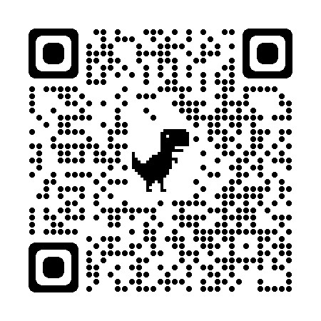
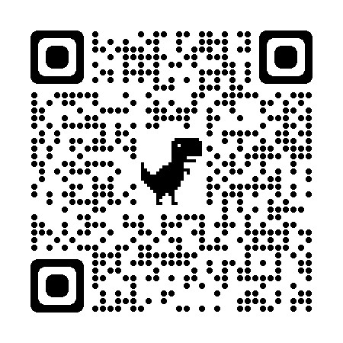
During weeks 3 to 6 of Term 1, teachers assess each Pre-primary student’s skills and understandings of oral language, reading, writing and numeracy.
The teachers will conduct the assessment one-on-one with each child. The information provided enables the teacher to plan for the learning needs of every child, including those who may need additional support or extension.
Many children who start school with limited skills progress quickly when provided with the right support.
As children progress, their needs may change. Teachers continually monitor their students’ progress to ensure the changing needs of every child are met.
We encourage you to talk to your child’s teacher to find out more about the On-entry Assessment or access the Dept of Education’s website for further information.
https://www.education.wa.edu.au/on-entry-assessment
https://www.northkalgoorlieps.wa.edu.au/
Please visit our Pre-primary web pages on the NKPS web site for more information specific to each classroom including timetables and classroom expectations.

Slide 10
Behaviour
Encouraging good behaviour through intrinsic motivators.
Class praise, encouragement from peers – a team philosophy.
GOTCHA’S for responsibility, respect, caring for others and personal best.
Blue Letters.
Honour Certificates – 2 per class at each fortnightly assembly
Visits to the office for good work (where possible)
School’s Responsible Behaviour Plan (copies available on request or on our website).
Use of 1, 2, 3 Magic program.
Teacher modelling of desired behaviours and strategies.

Slide 11
Parents as partners
Two-way partnership. You are your child’s first teacher, and we are a team.
Regular attendance is critical. Try to be punctual so that your child doesn’t miss out on learning. The doors will open at 8:35 am for students to enter. Please say your brief goodbye outside before you leave.
If possible, try, try try to avoid taking holidays during the school term.
Talk to your child about their day (when they are ready) and encourage a love of learning.
Comprehension Readers will be provided weekly. An explanation and questions are in each book. 5-10 minutes each night will go a long way toward building oral language skills. This is valuable, should happen daily and be FUN!
Play board games, cards, make-believe/role play together and physical games outside too.
PLD Parent Education https://pld-literacy.org/product/foundation-parent-education-sheets-and-downloads-semester-1/

Slide 12
Why should I read with and to my child at home?
Research shows that reading aloud to your child is the single most important thing you can do to prepare your child for reading and learning.
Models what good reading sounds like.
Nurtures a love of reading of good quality literature.
Strengthens bonds with your child.
Develops oral language through discussion.
Builds background knowledge and understanding through factual texts.
Expands their vocabulary.
Learn more about interests and hobbies.

Slide 13
Communication
Please see me if you have any concerns about your child or any questions.
No question is a silly question. We are in this together.
Keep your contact details up to date.
Please read notes thoroughly, check Connect for the school newsletter and check your child’s school bag too!
Take a look at our website - updated regularly.
We will celebrate many ‘special days’ as part of the NKPS community & families are very welcome to participate – actually we encourage it.
Parent interviews/phone calls towards the end of Term 1 after results from the On-Entry Testing.

Slide 14
Other information and contact details
Phone the school on 9092 5850
To make an appointment, chat outside the classroom, in a phone call in a meeting.
Email – louise.hurst@education.wa.edu.au;
Please pack a labelled change of clothes for your child every day. Play can be messy!
Please bring in stationery and the student questionnaire if you haven’t already.

Slide 15
Thank you for your time.
Any questions?
Please contact us.
Email – louise.hurst@education.wa.edu.au;

Slide 16
Brief Overview of term one – Kindergarten Literacy
Introduction to rhyming
Syllables
Name recognition
Name writing/tracing
Modelled reading & viewing behaviours
Print awareness
Following instructions
Sharing / turn taking
Using drawing to convey ideas

Slide 17
Brief overview of term one – Kindergarten Numeracy
Number & Algebra
Recite numbers to 5
Recognise numerals to 5
Subitise small collections up to 4
Subitise standard patterns on a dice
Compare collection – more/less, same/not same
Copy and create simple patterns
Measurement and Geometry
Name, sort and match basic 2D shapes

